Slide 1
NAND Gate
Matthew Ernst
3.3.2017

Slide 2
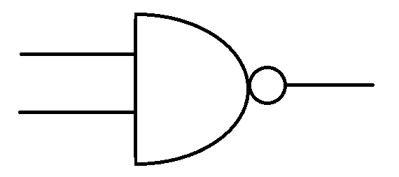
What is a NAND Gate?
A NAND Gate is a Boolean logic operator that works on the system that as long as one input is false, then the output will be true.
The output of a NAND Gate is the exact opposite of an AND Gate.
It can be thought of as AND with a NOT inverter.

Slide 3
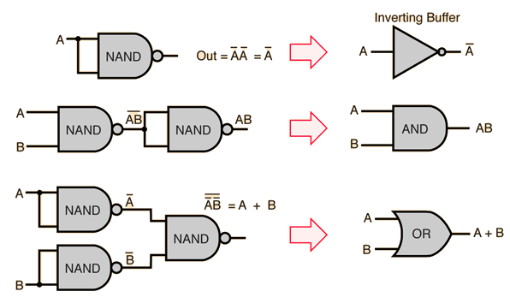
Why is NAND a universal gate?
A NAND Gate can be used to produce any different kind of other gate.

